Slide 1
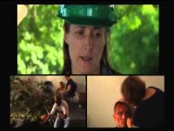

Slide 2

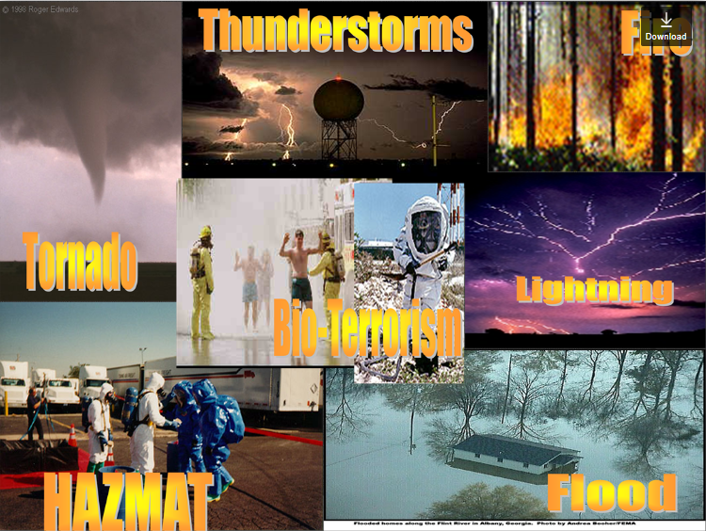
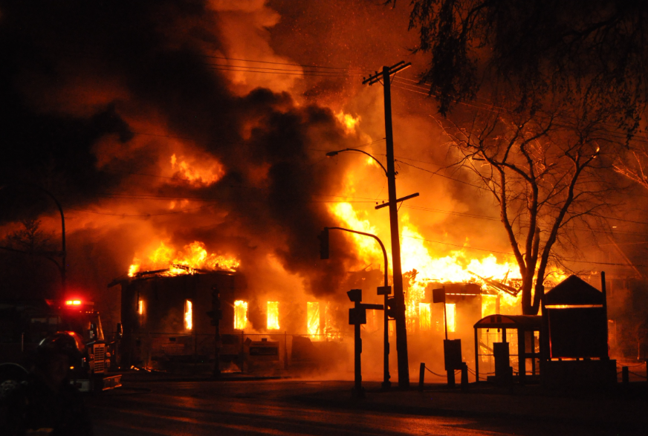
Response Communities Deploy
S
T
a
R
T
Simple
Triage
and
Rapid
Treatment
When Disasters Happen
An application used by community-based organizations who are prepared to serve as a crucial resource capable of performing many of the emergency functions needed in the immediate post-disaster period or in emergencies.
MOT Team
Farah Muttardy
Richard Ogniewski
Elie Tannouri

Slide 3
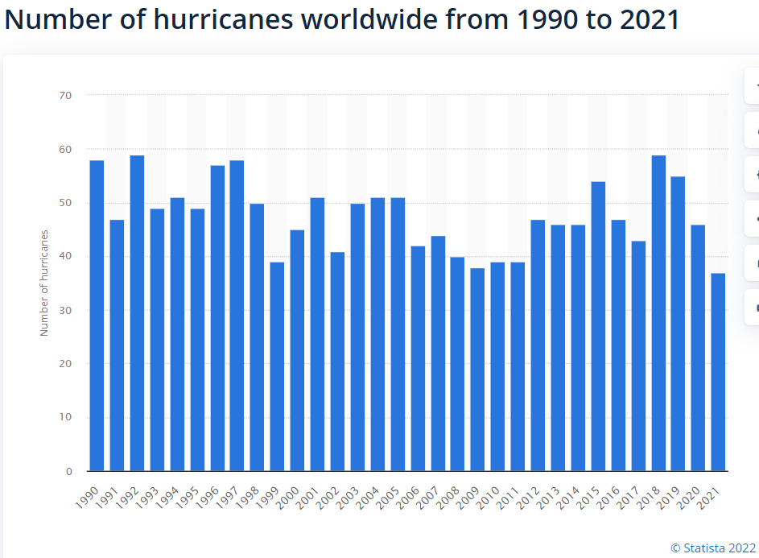
Notes:
This graph shows the number of hurricanes in the last 30 years. These emergencies have the ability to cause large-scale damage and threaten human health and safety, property, and infrastructure. It’s difficult to predict exactly when a natural disaster will occur and the impact it will have. Damage from these events can be catastrophic and they can lead to the loss of property, suffering from injuries, and even death.

Slide 4
Disasters in Numbers (USA)
Year | Disaster | Cause | Fatalities | Damage (US$)
1862 | Great flood of 1862 |  | 4,000+ | $ 100,000,000
1899 | San Ciriaco Hurricane | Tropical Cyclone | 3,389 | $ 20,000,000
1906 | San Francisco Fire | Earthquake | 3,000+ | $ 235,000,000
2001 | September 11 Attacks | Terrorism | 2,996 | $ 10,000,000,000
2005 | Hurricane Katrina | Tropical Cyclone | 1,245-1,836 | $125,000,000,000
2017 | Hurricane Maria | Tropical Cyclone | 2,982 (est.) | $ 94,500,000,000
Notes:
This is a sample of some of the disasters that happened in the US, nature or human-made. The fire of San Francisco destroyed 80% of the city. Can you imagine if this were to happen today in a big city? Can we cope with it. Well, we had a sense of the same when September 11 happened. Some of us are who old enough to remember that tragic event can never forget what took place. Hundreds of casualties, sky-scrapers collapsing. Unfortunately, when both towers of the World Trade Center fell, it killed the emergency responders that were present totally 343 firefighters and 71 police officers. September 11 was the most deadly event for emergency responders in the history of the United States.​

Slide 5
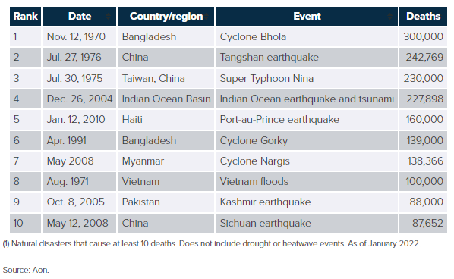
Disasters in Numbers (Global)
Notes:
Just in the last 50 years, the top 10 natural disasters at the global level led to 1 ¾ million deaths… if you notice, these disasters occurred in countries that are not as advanced as the USA, bar China. Do you believe for a second that ER teams in these countries were able to respond to citizens urgent needs?...

Slide 6
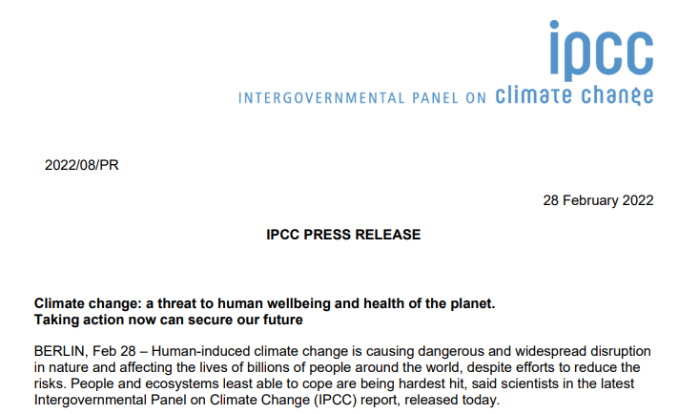
Notes:
Research is telling us that natural disasters are becoming more a fact of life. In a recent press release by IPCC (The Intergovernmental Panel on Climate Change (IPCC) which is an intergovernmental body of the United Nations warned us about the potential loss of billions of people…

Slide 7
Impact of Changing Weather
According to NASA:
For most places, global warming will result in more frequent hot days and fewer cool days, with the greatest warming occurring over land. Longer, more intense heat waves will become more common. Storms, floods, and droughts will generally be more severe as precipitation patterns change. Hurricanes may increase in intensity due to warmer ocean surface temperatures.
Source: Global Warming (nasa.gov)
Notes:
Emerging evidence suggests that global warming is already influencing the weather. Heat waves, droughts, and intense rain events have increased in frequency during the last 50 years, and human-induced global warming more likely than not contributed to the trend.
A study done by Balaguru et al. (2022) reports an increasing trend in hurricane intensification rates near the U.S. East Coast since 1979.

Slide 8
Is Emergency Response up to par…?!
“In the case of hurricanes and major weather events, physical and technical roadblocks often prevent response teams from obtaining critical data to track damages, prioritize response needs, and keep the public informed so that people know how to stay safe,” wrote Harvard Business Review.
Notes:
Having determined the risks of disasters all over the world and the potentials for human losses, communities need to stand ready to help for the mere fact that ER are uncapable of handling the work load of major disasters. An article by Harvard Business Review dated December 1, 2017 entitled: “How the Internet of Things Can Prepare Cities for Natural Disasters”, the authors eluded to that.
Today, disaster responders gain reliable, timely information only when they reach an emergency zone and take stock of the situation. This is not an easy task in the case of hurricanes and major weather events, that’s why there is a high demand for community members to join in any type of disaster recovery effort.

Slide 9
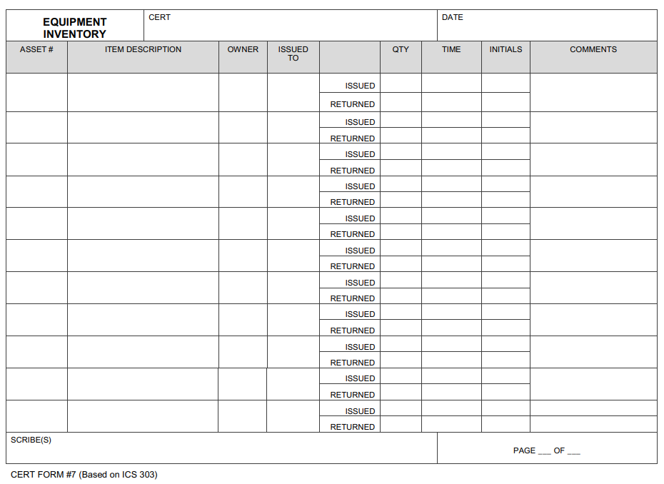
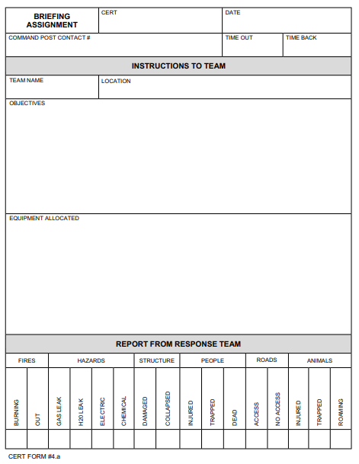
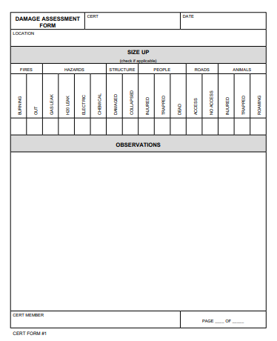
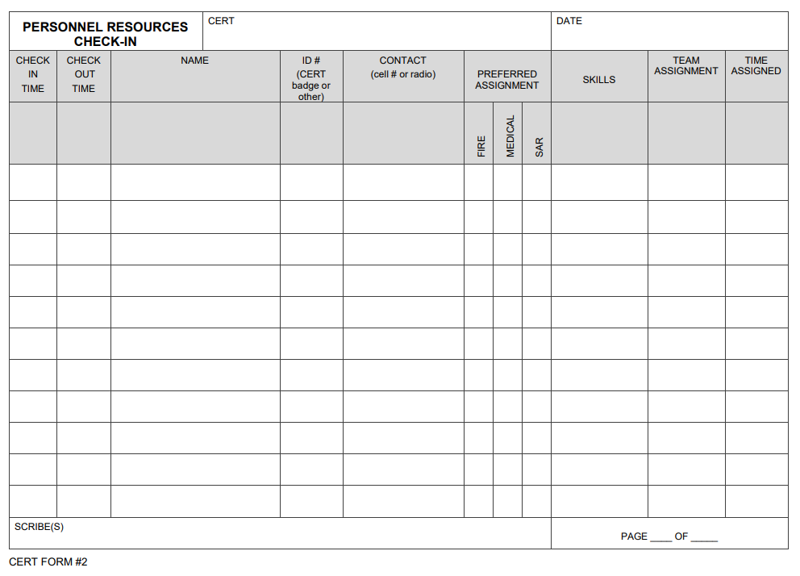
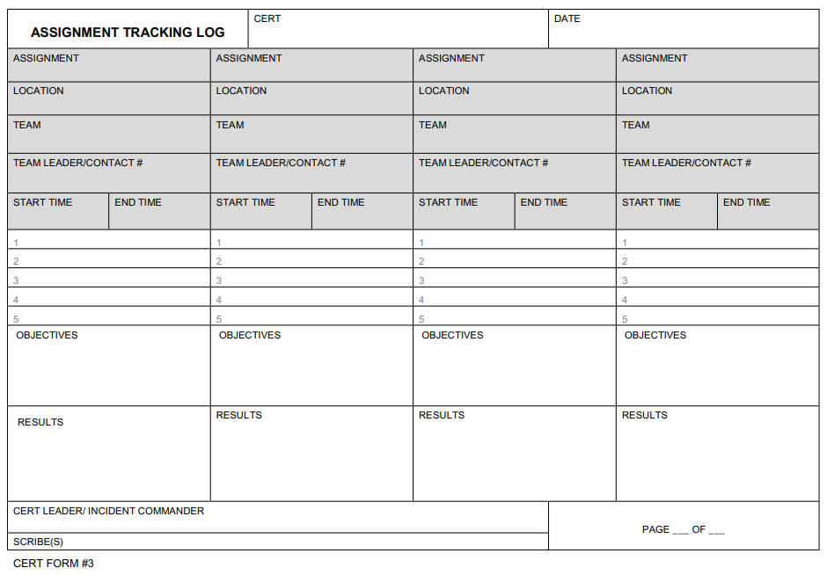
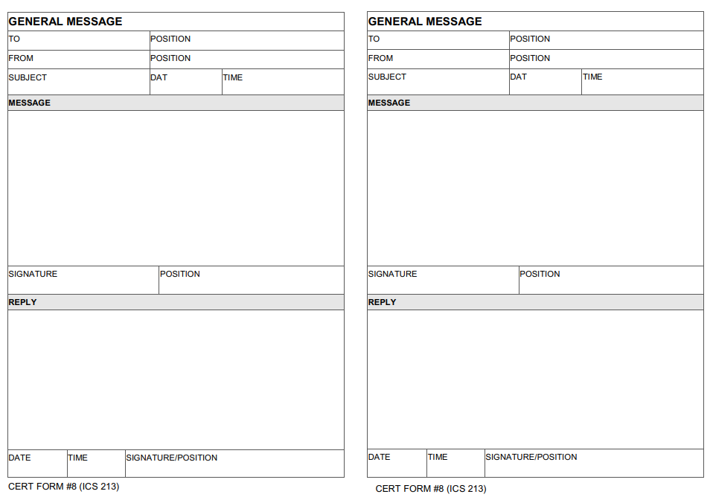
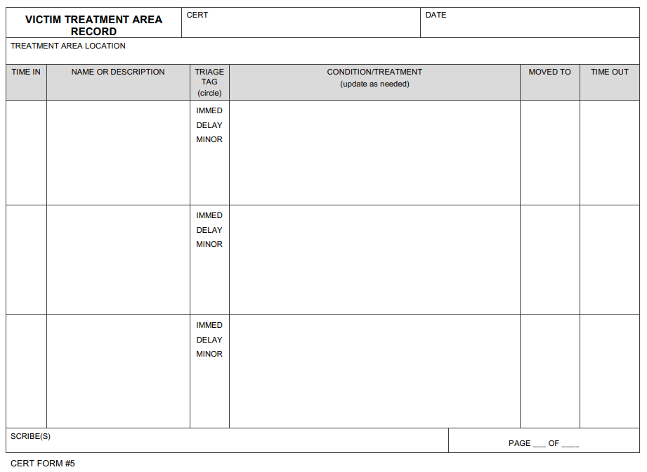
Forms
Notes:
There are established programs and guidelines for community-based support in the case of disaster recovery. These are the efforts of volunteers who have been trained on this type of service. To support their mission, there are many forms that get to be filled out during a disaster recovery phase. Some of these, not all, are the ones presented here.
Please take a look at this last form, … and think about the challenges of compiling, consolidating, integrating so many pieces of manual data in order to get an assessment of the magnitude of losses.

Slide 10

Challenges with Current Reporting Structure
Too many hand-written reports
Inadequate integration, coordination, and classification of data
Data interoperability
Slow to assess leading to delay in reaction
Conducive to slow productivity
Can lead to missing important details
Notes:
According to Challenges with Disaster Mortality: approximately 60% of deaths go unaccounted for in registration systems globally. The risk of death is greatest among marginalized groups least likely to be identified in census data, such as those with disabilities and ethnic minorities. This also has implications for the robustness and ability to disaggregate that data. During the emergency response phase of a disaster, casualty numbers are typically approximated using body counts, household or hospital surveys, and inferences from assessments of infrastructural damage.
That’s why we believe there is a need for a mobile application that can track casualty reporting we call it: STaRT

Slide 11

What does STaRT do…?!
Faster data collection
Consistency and better accuracy in reporting
Reduction in processing time
Immediate up-to-date statistics
Notes:
All these benefits will successfully lead to 3 main outcomes:
1- quicker and more focused effort from emergency response teams
2- faster communication to the public
3- better alert notifications in post-disaster period

Slide 12
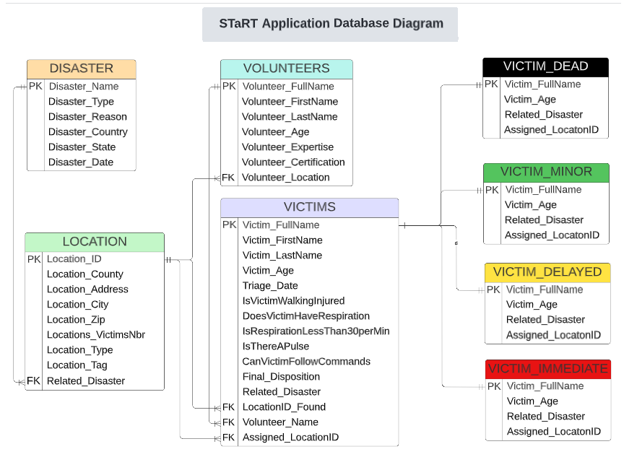
Database Design

Slide 13
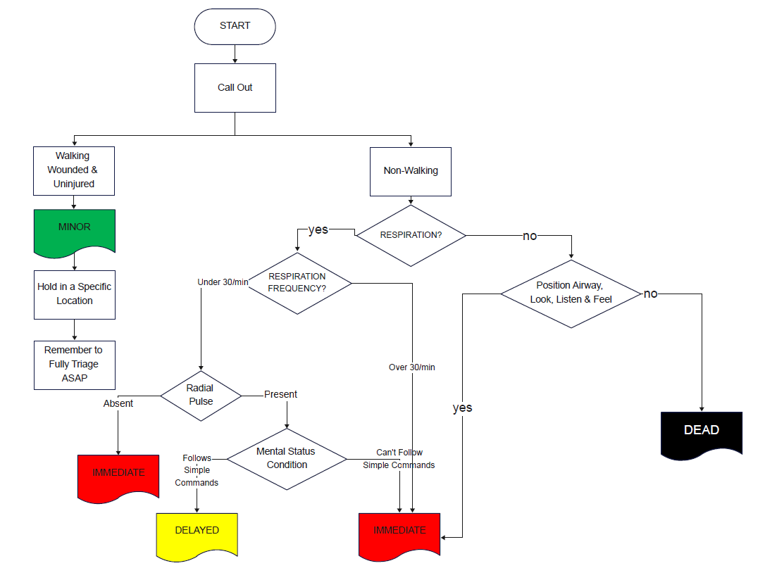
Victim Processing Flow
Source: FEMA.Gov
Notes:
This diagram flow shows the steps taken by responders to determine the classification, call it disposition, of victims. We will not go over all the details of this diagram, but we can take one decision tree for determining if a victim is dead…

Slide 14
Application Demo
Now we will present the MVP (Minimum Viable Product) model we created

Slide 15
Flask Demo
Our Flask Demo is complete with respect to introduction (home, about pages) with one database table update only

Slide 16
What Were the Challenges?
No comparable application
The technical setup of MySQL
The integration between Python and MySQL
The integration between Python and Flask, Flask and MySQL
Handling HTML complexities

Slide 17
Software Development Roadmap
Release 1 – Beta (complete): Capture the basic foundational data related to:
Disasters
Locations
Volunteers
Victims
Release 2: Complete the cycle as well as adding other reporting features, such as: equipment
Release 3: Avail a mobile app on iOS and Android for basic data collection and knowledge sharing
Release 4: Emergency push notifications, instant communication and coordination (a la Waze and the Emergency Notification System)
Notes:
A la Waze implies using crowd-sourced information…
VESTA Communicator Data Sheet (motorolasolutions.com)

Slide 18
References
Intergovernmental Panel on Climate Change (IPCC)
The Society for Disaster Medicine and Public Health Inc.
Disaster Risk Reduction: Why Do We Need Accurate Disaster Mortality Data To Strengthen Policy And Practice? Dell D Saulnier et al, published May 31, 2019. Sources: Govt. Cambodia, Govt. Malaysia, Karonlinska Institulet, UN Office for Disaster Risk Reduction
Natural Disasters - Our World in Data
Challenges with Disaster Mortality Data and Measuring Progress Towards the Implementation of the Sendai Framework. Helen K. Green, Oliver Lysaght, Dell D. Saulnier, Kevin Blanchard, Alistair Humphrey, Bapon Fakhruddin, Virginia Murray, Int. J Disaster Risk Sci, 30 October 2019
How the Internet of Things Can Prepare Cities for Natural Disasters. Kris Tremaine and Kyle Tuberson, Harvard Business Review, December 01, 2017
Grade Tracker, Web Page with Flask, Vinventory projects. Kennesaw State University, GA, HMI 7540 – Healthcare Info Systems Development

Slide 19

MOT
Farrah Muttardy
Richard Ogniewski
Elie Tannouri
Thanks!

